Slide 1


Coffee Shop Analysis
By: Diseph Dum-Igoni

Slide 2
Overview
Data Cleaning & Preparation
Data Exploration
Visualizations
Key Insights
Recommendations

Slide 3
Data Cleaning & Preparation
Checked for
Duplicates and
inconsistences.
01
Handled missing
Values & deleted
empty columns.
02
Merged the relevant
data into a single
sheet.
03

Slide 4
Data Exploration
Calculated the profit margin for each product, using the formula:
Profit x 100
Selling Price 1
01
Used Pivot tables to
Explore the data in order
To answer the questions given.
02

Slide 5
Visualizations

Slide 6
1. Trend of Sales by Coffee Type
Sales increased by 13% between 2019 and 2021 before falling by 48.7% in 2022.

Slide 7
2. Top Ten Customers by Sales
S/N | Customer Name
1 | Allis Wilmore
2 | Brenn Dundredge
3 | Terri Farra
4 | Nealson Cuttler
5 | Don Flintiff
6 | Derick Snow
7 | Brice Romera
8 | Alexa Sizey
9 | Ailey Brash
10 | Nanny Lush

Slide 8
3. Total Sales by Country
79% of Total Sales comes from the US, with the top states being Washington, Texas.

Slide 9
4. Total Orders by Coffee Type
Ara is the most purchased coffee type.

Slide 10
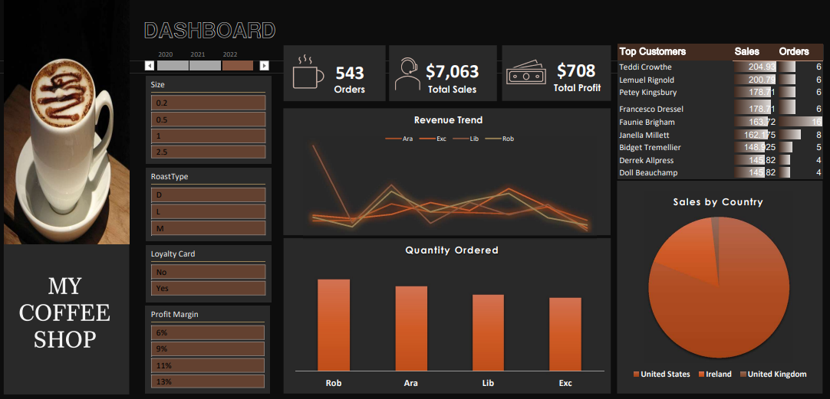
5. Final Dashboard

Slide 11
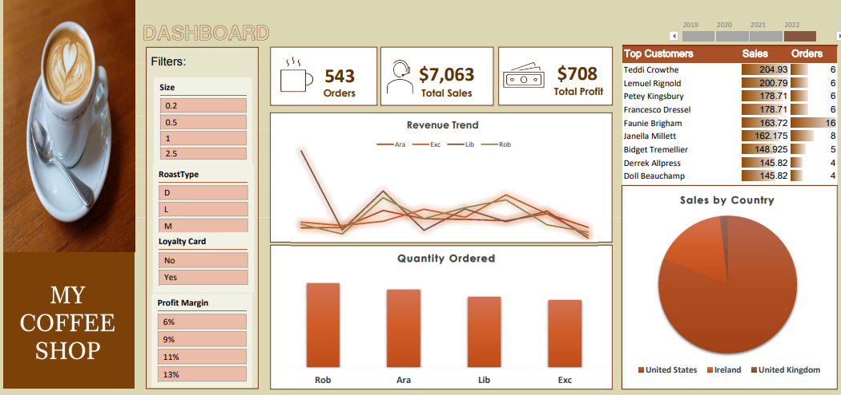
6. Final Dashboard

Slide 12
Insights

Slide 13
Key Insights & Recommendations
Insights
Recommendations
The business has generated over $45,000 in revenue but made only 10% of the amount as profit.
The most purchased coffee types are Rob and Ara, but they have the lowest profit margins.
The USA is our biggest market.
Most customers don’t use a loyalty card.
Most purchases are for 0.2g and large roasts.
Investigate the fluctuation in sales.
Targeted efforts and campaign.
Investigate profit margin on popular products.
Keep popular products in stock.
Consider new incentives.
Strengthen relationship with top customers.

Slide 14

Thank you.

